Slide 1


“Scan4Reco: Towards the digitized conservation of Cultural Heritage Assets via spatiotemporal (4D) Reconstruction and 3D Printing”
Authors: N. Dimitriou, A. Drosou & D. Tzovaras
Presenter:
Dr. Nikolaos Dimitriou
Post-Doctoral Fellow

Slide 2








Scan4Reco participants
Participant No | Participant organisation name | Short Name | Country | Org. Type
1 (Coordinator) | CENTRE FOR RESEARCH AND TECHNOLOGY HELLAS | CERTH | Greece | Research
2 | IDRYMA ORMYLIA | OF-ADC | Greece | End User
3 | UNIVERSITY OF VERONA | UNIVR | Italy | University
4 | OPIFICIO DELE PIETRE DURE | OPD | Italy | End-User
5 | CENTER FOR ADVANCED STUDIES, RESEARCH AND DEVELOPMENT SARDINIA | CRS4 | Italy | Research
6 | FRAUENHOFER INSTITUT | FRH IGD | Germany | Research
7 | BWTek Europe GmbH | BWTEK | Germany | SME
8 | Avasha AG. | AVASHA | Switzerland | SME
9 | RESEARCH FOR SCIENCE, ART & TECHNOLOGY (RFSAT) Ltd | RFSAT | UK | SME

Slide 3
Scan4Reco motivation
With respect to CH documentation & preservation, the following holds:
  enormous European Cultural Heritage (CH) including a vast and rich variety of cultural items
  different materials with different ageing patterns
  different restoration procedures
  multi-factorial reasons for the CH deterioration
  lack of detailed & efficiently collectable documentation
  enriched 3D representations (printed or digital) is valuable for conservators
  limited accessibility to public

Slide 4
Scan4Reco in a nutshell
Scan4Reco will facilitate the preservation, conservation, curation, restoration & the documentation via automatic digitization of a wide variety of cultural heritage assets even in situ, using:
  multispectral scanning and digitization following a semi-automatic procedure,
  material exploration using multiple sensors,
  identification and modelling of CH assets deterioration, allowing spatiotemporal simulation and facilitating conservation.
  demonstration of digitized CH assets in a virtual museum
  tactile multilayered surrogates for both scientific and commercial usage.

Slide 5
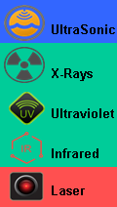

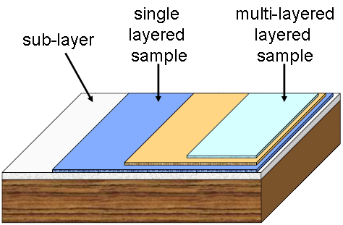
Basic components
Reference material palette – Material Booklet
Ageing models
Multi-sensorial platform
  Depth cameras /ToF sensors
  Microprofilometer
  Ultrasonic scanner
  Infrared (class Raman) scanner
  X-Ray Fluorescence
  Reflectance Transformation Imaging
Spatiotemporal simulator
3D/4D reconstruction
Automatic fault detector & annotator
Conservation related Decision Support System
3D Printing (incl. anisotropic visual information)
Visualization
Virtual Museum
VR
5

Slide 6
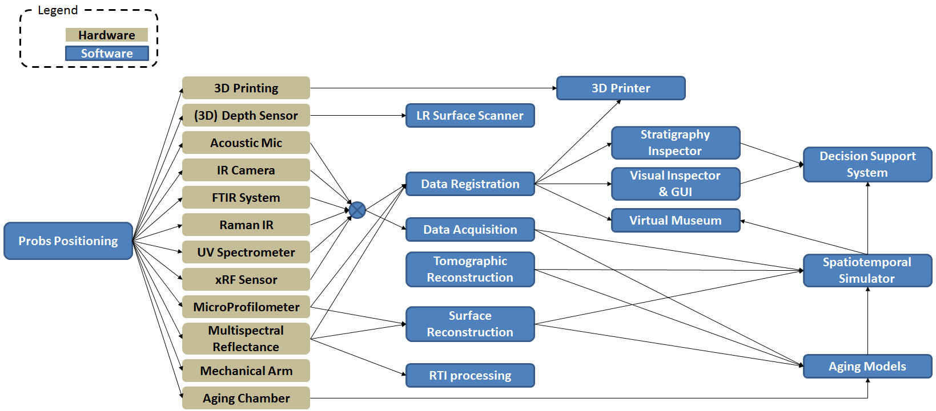
Scan4Reco Architecture

Slide 7
Scan4Reco Architecture
Assisted Positioning Subsystem

Slide 8
Scan4Reco Architecture
Global Scanning and Registration Subsystem

Slide 9
Scan4Reco Architecture
Subsurface physical and chemical acquisition & characterization subsystem

Slide 10
Scan4Reco Architecture
Surface acquisition & characterization subsystem

Slide 11
Scan4Reco Architecture
Samples/Artwork preparation and aging subsystem

Slide 12
Scan4Reco Architecture
Exploration & Analysis subsystem

Slide 13
Scan4Reco Architecture
Physical Replication subsystem

Slide 14
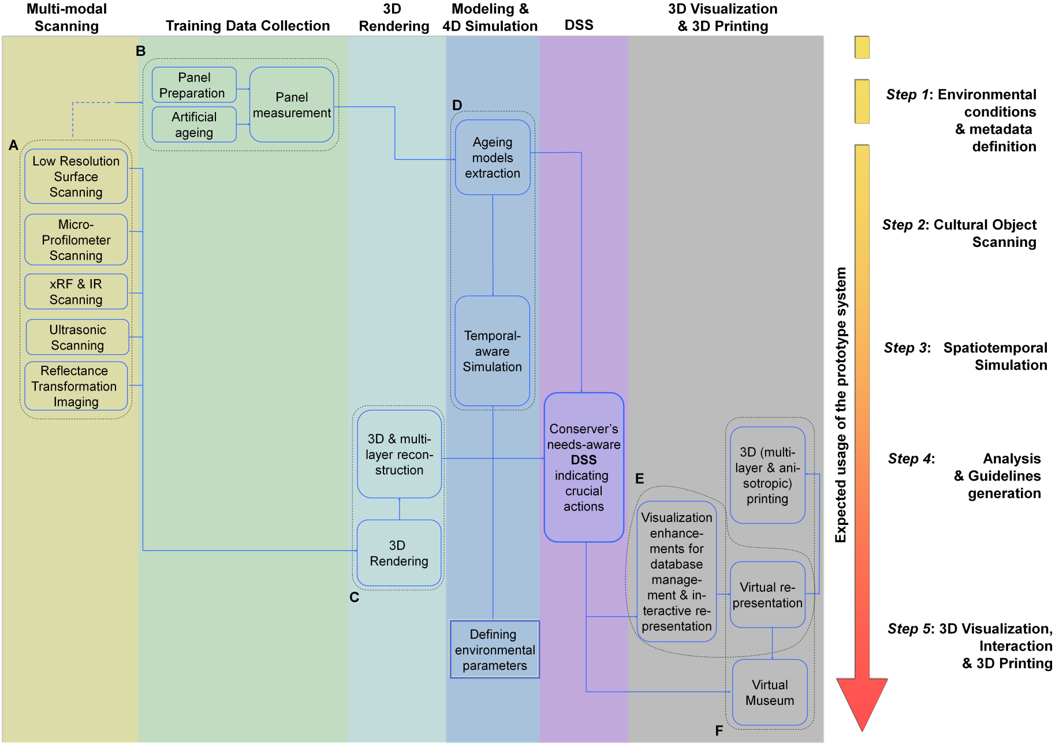
Scan4Reco Architecture: Vertical View

Slide 15
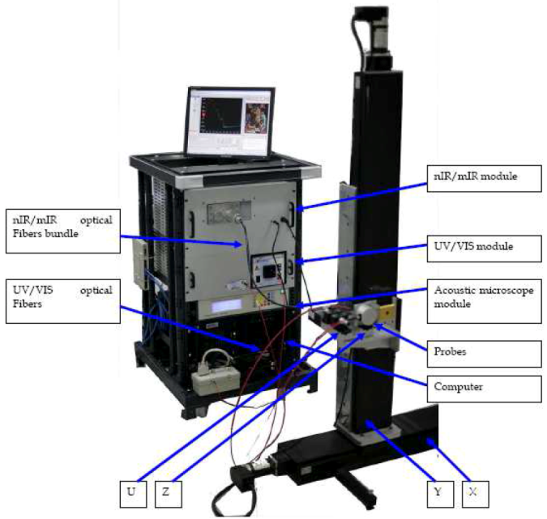
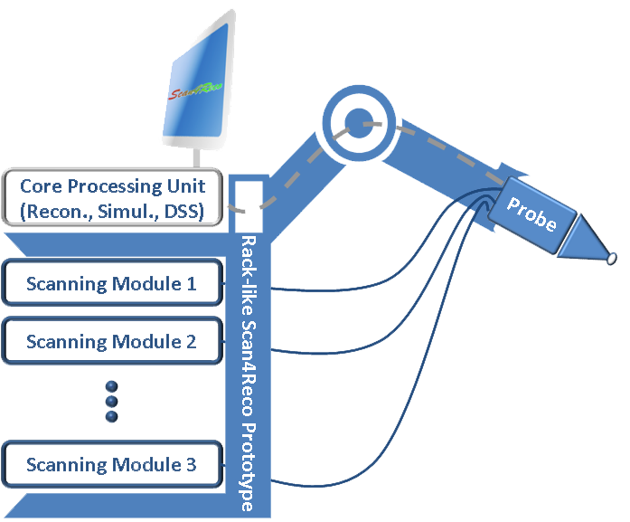


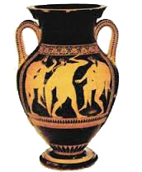


Conceptual Integrated System*
VR
Rotating Table
*The presented illustration renders only a concptual perception of the final prototype. The actual product may significantly differ in shape, style design & usage.
15

Slide 16
Envisioned Use-Cases (1/2)
Paintings
Where?
…in the conservation laboratories of “Ormylia” Foundation located in Ormylia Foundation laboratories.
Who?
…Conservation scientists and conservators
What?
…art objects that are received in the Lab for documentation services from the real market
…available real painted art-objects from Mount Athos
Why?
…scanning with the various modalities
…reconstruct the tomographic information using the 3D visualization models.
…stratigraphy determination (acoustic microscopy)
…elements detection in the layers (xRF)
…evaluation of the chemical changes in the materials (FTIR and Raman spectroscopies)
…3D reconstruction & printing to see if the information provided is useful for the conservation treatment of the art object. From this procedure, the following system components will be utilized and evaluated in the real case object accordingly

Slide 17
Envisioned Use-Cases (2/2)
Metallic and other 3D objects
Where?
…museums of the “Soprintendenza” of Venice and of Verona and by the OPD national restoration facility.
Who?
…professional conservation scientists of the museums and institutes
What?
…metallic and other 3D objects will be carried out on genuine artworks (e.g. bronze sculptures and reliefs, silver alloy jewellery, wax sculptures, glasses, etc.)
Why?
… scanning of the surface with the multi-modal and multi-sensor platform and reconstruct the information at multiple scales using the 3D visualization models.
…object reconstruction (commercial depth sensors/cameras)
…quantitative representation of the surface texture & roughness at micrometric level (microprofilometry).
…model of materials reflectance and geometric information/details (multispectral RTI)
… reference palette & artwork inspection, conservation status, ageing and proposed treatment (visualization & 3D printing of the reconstructed object, material morphology and stratigraphy)

Slide 18
Technological Innovation
Key innovation points summarized:
Material exploration and modelling of their ageing characteristics
Technology transfer between Applied Physics and Computer Science towards a novel non-destructive diagnostic technique
Multi-scale optical scanning microprofilometry for in-situ diagnostics of genuine artworks
Combination of MSI & RTI technologies
xRF scanning method, the IR (class Raman) techniques in combination with Ultrasonic signals will be evaluated and used for volumetric reconstruction.
Fusion of multi-sensorial data acquired from artworks for an enhanced view and understanding of CH
3D visualization of the stratigraphy via combination of multi-spectral information
DSS complex conservation guidance based on simple ‘naïve’ commands inferring from a wide range of heterogeneous and partially complementary data
Reducing the data size for storing material reflectance data,
Manage to reproduce anisotropic reflectance in 3D printing
Visualization enhancing the end-user experience.
18

Slide 19

Questions & Answers
Contact Details: Dr. Nikolaos Dimitriou
nikdim@iti.gr
Visit Scan4Reco’s site: http://scan4reco.eu
Centre of Research & Technology - Hellas
Information Technologies Institute

Slide 20
Summary: What can Scan4Reco offer?
Revealing the time of creation
  The stratigraphy identification revealing the art school of the painting & possible overpaintings
  Surface morphology at multiple scales revealing hidden 3D features made in the creation of the artifact or in a conservation intervention
  Surface roughness texture measuring the outset of corrosion, degradation, and the effects of cleaning and protective treatments
  Materials reflectance, glossy and colour changes, tracing alteration and monitoring aesthetic aspects also linked to material stability
  Physical aspects of the surface for setting the alarm thresholds of alterations, combined with chemical data from punctual technique
Ageing models
  The degradation of the materials revealing the environmental conditions of past preservation
Simulation module
  Support the multi-sensorial platform in order to identify the degraded materials
  Support the multi-sensorial platform in order to discriminate features in surface morphology
  Support the daily practice of eye’s inspection
Visual Volumetric & Surface Reconstruction and 3D printing
  The overall ‘adventure’ of the object in time and in space through the 3D visualization model
  Fine guidance to the conservator / restorer to curate accurately the painted art object
  Document the history of surface artifact through the 3D visualization model
  Support choices of the conservator to preserve the artifact and guide treatments
  Replica of the object and restoration phases for educational use, exhibitions and events
20

Slide 21
Objectives (1/2)
Objective 1: …to provide an integrated, portable solution based on a modular architecture, for accurate (i.e. via a dedicated motorized mechanical arm) multi-sensorial 3D scanning and efficient automatic digitization of a big variety of cultural/heritage assets even in situ, supporting among others material identification and both surface and volumetric diagnosis.
Objective 2: …to apply a hierarchical approach for 3D reconstruction of the object via the successive collection and utilization of the multi-sensorial data in an order of increasing resolution and infiltration factor, making thus, possible, to render the object in a multi-layered way, so as to facilitate its deployment in analysis and 3D printing procedures
Objective 3: …to create high precision and realistic digital surrogates of the cultural assets by also providing detailed insight regarding both the surface but also the volumetric structure, material composition and shape and structure of the underlying materials, so as to render them visible to the unaided eye either via occlusion capable visualization techniques or via transparent multi-material 3D printing.
Objective 4: …to apply systematic study and methodical material analysis through state-of-the-art laboratory techniques, so as to understand the heterogeneous nature and complex structures, to identify the broad and varied class of materials and to understand their degradation mechanisms over time, targeting to the extraction of the appropriate parameters able to accurately describe context-dependant ageing models per material.

Slide 22
Objectives (2/2)
Objective 5: …to spatiotemporally (4D) simulate uni-material models individually based on certain environmental phenomenon modeling (i.e. context-dependent), so as to collectively render imminent degradation effects on the multi-material cultural objects in an attempt to predict and to recreate the appearance of the cultural object in specific times in the future or even to perform reverse engineering so as to achieve the automatic restoration, reaching even back to its original shape.
Objective 6: …to indicate, the invisible to an unaided eye, spots/segments of the cultural object that are in eminent conservation need and require special care, while to simultaneously provide suggestions by a dedicated Decision Support System (DSS), regarding the most appropriate conservation method that should be followed, in the most comprehensive and analytic way to the conservator via enhanced interactive visualization methods, for both gaining from human intelligence and allowing metadata collection/updating
Objective 7: …to validate the aforementioned actions on real case scenarios involving heterogeneous objects of various sizes and materials, as well as to identify probable research challenges for the future
Objective 8: …to enhance the accessibility of the digitized cultural objects (along with the outcomes of the project) to both the scientific community, the field experts and the general public via the development of a virtual model of a museum where all scanned artifacts will be virtually exposed

Slide 23
Challenges by the REFLECTIVE-7 Call
Interdisciplinary, inter-technology collaborations.
Documentation of Cultural Assets to enhance the understanding of Cultural Heritage (CH).
Digital models to become the representation forever, for everybody, from everywhere.
Tools for automated 3D modelling and analysis of CH assets.
Beyond SoA 3D representations supporting information.
Integration/linking, shape-related analysis, etc., adding thus, a laboratory dimension to on-site explorations.
Standard formats for the semantic-aware 3D modelling of Europe's cultural heritage.
Digital reconstructions to be provided in interoperable formats
Standardisation activities for the applicability, usability and sustainability of the 3D models.
10/5/2016
23

Slide 24
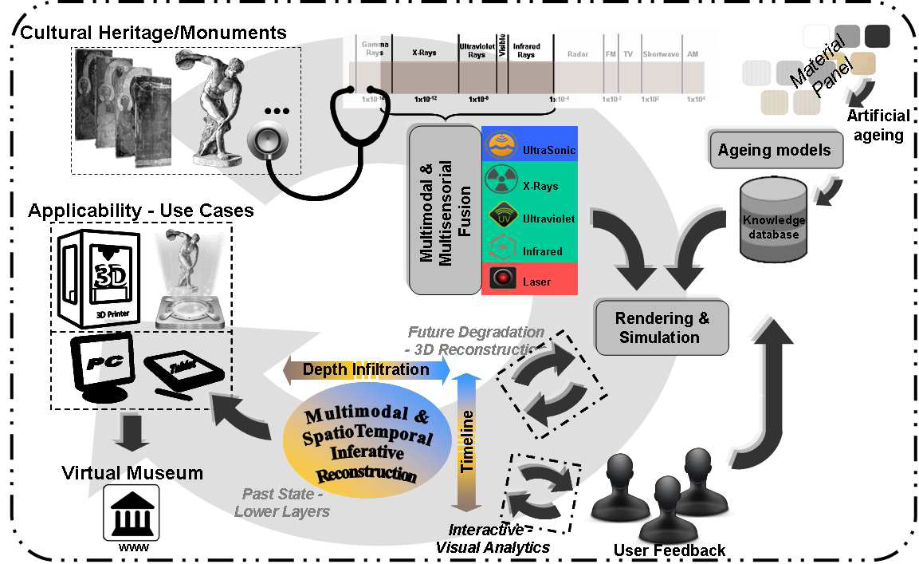
Conceptual Architecture

Slide 25
Deliverables (1st year)
WP1
Del. No. | Del. Title | Type - Dis. Level | Leader | Due Date
D1.1 | Project Quality Management & Risk Assessment Plan | RE - CO | CERTH | M3
D1.2 | Data Management Plan | RE - PU | OF-ADC | M6
D1.3 | Ethical Issues Manual | RE - PU | OF-ADC | M5
D1.4 | Minutes & Attendance List (1st RP) | RE - CO | CERTH | M12

Slide 26
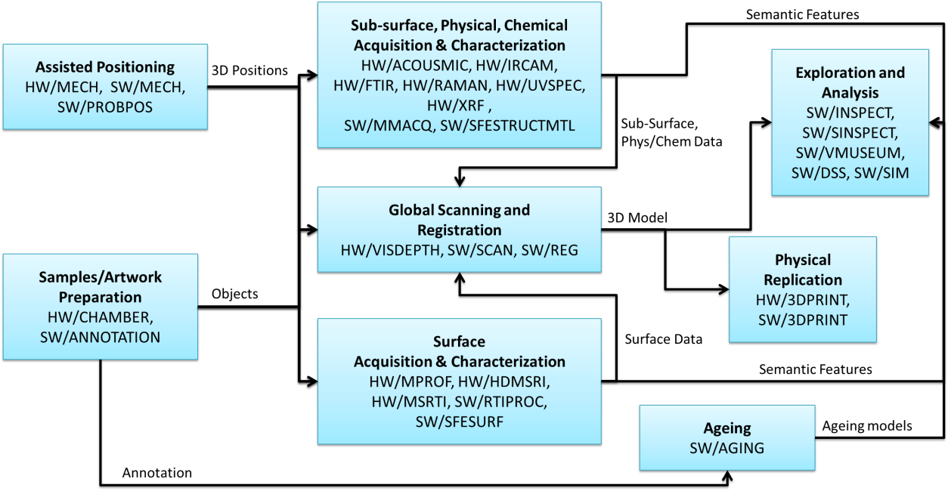
Scan4Reco Architecture

Slide 27
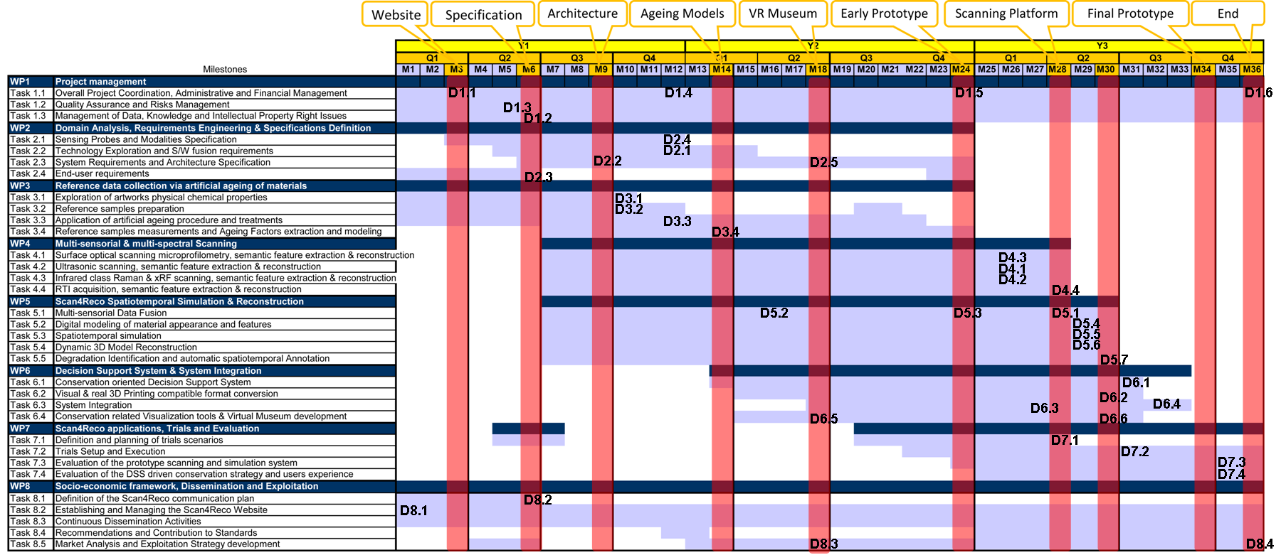
Gantt Chart
M12 Project Review

Slide 28
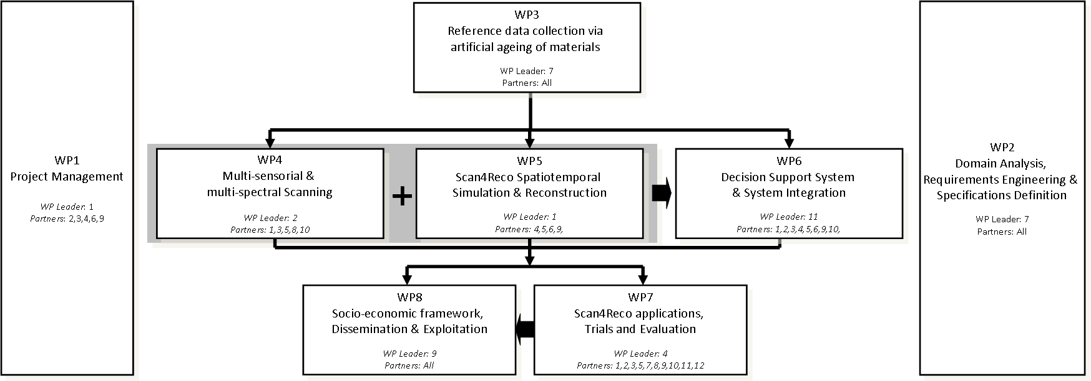
WPs inter-relation
Pert Diagram

Slide 29
Deliverables (1st year)
WP2
Del. No. | Del. Title | Type - Dis. Level | Leader | Due Date
D2.1 | Technology exploration report | RE - CO | RFSAT | M12
D2.2 | System Architecture definition | RE - PU | CRS4 | M9
D2.3 | Scientific end-user & public require-ments | RE - PU | OPIFICIO | M6
D2.4 | Initial report on System specifications | RE - CO | OF-ADC | M12

Slide 30
Deliverables (1st year)
WP3
Del. No. | Del. Title | Type - Dis. Level | Leader | Due Date
D3.1 | Material related Booklet | RE - CO | OF-ADC | M10
D3.2 | A guide for multi-material palette preparation | RE - PU | OF-ADC | M10
D3.3 | Procedures and application of artificial aging | RE - PU | OPIFICIO | M12

Slide 31
Deliverables (1st year)
WP8
Del. No. | Del. Title | Type - Dis. Level | Leader | Due Date
D8.1 | Scan4Reco Website | DEM -PU | CERTH | M1
D8.2 | Communication Plan | RE – PU | AVASHA | M6

Slide 32
Milestones (1st year)
Milestone No. | Milestone name | Related WPs | Est. date | Means of verification
MS1 | Website deployment | WP8 | M3 | Timely completion of website launch
MS2 | Specifications | WP2 | M6 | Timely completion of Specifications definition
MS3 | System Architecture definition | WP2 | M9 | Timely completion of System’s Architectural Design

Slide 33
Key Performance Indicators (1st year)
Measures & indicators
Type | Key Performance Indicator | @M12 | @M24 | @M36
Scientific excellent of project research activity | Number of published works by Consortium partners (cumulative) | 3 | 10 | 25
 | Number of invited speeches/keynotes (cumulative) | 1 | 2 | 4
Level of integration among partners | Number of joint publications (cumulative) | 1 | 5 | 15
 | Number of visits to other partners for carrying out joint work (cumulative) | 1 | 3 | 6
Level of visibility of the initiative at the European and global level | Average monthly visits of the project Web site | 150 | 350 | 700
 | Total number of documents downloaded from the project Web site | 100 | 500 | 1500
 | Number of articles in blogs/magazines/news (cumulative) | 6 | 14 | 20
Progress on pilot sites | Number of users actively participating to the Scan4Reco activities | 30 | 100 | 300
 | Number of institutions providing a formal expression of interest to adopt the Scan4Reco approach | 1 | 3 | 8
Community engagement: | Number of attendees at the project workshops; | N/A | N/A | 80/120
 | Number of partnerships with external institutions working on similar themes | N/A | 2 | 5
Progress on business modelling activities | Number of new business models identified | N/A | 1 | 3

